Slide 1
Generative Modelling and Feature Interpretation using VAEs and GANs
Machine Learning in Medical Imaging – Team 5
Tutor: Anjany Sekuboyina
Team:s
Abdelrahman Elskhawy
Alessandro Mauro Colelli
Sweety Mohanty
Wasiq Rumaney

Slide 2
Motivation

Slide 3
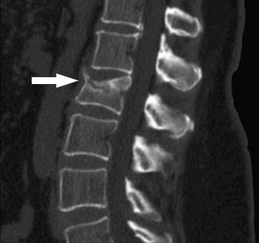
Motivation
Spine is the reason why all the internal organs stay in place and function as they should.
~70% of vertebral fractures went undiagnosed
Classification approach requires plenty of fractured vertebrae data
CT scan showing a vertebral compression fracture
Goal
Generate vertebral segmentation masks using Variational Autoencoders (VAEs), and Generative Adversarial Networks (GANs).
Compare both of them in terms of generation capability, and latent space modeling.
Build a deep net to detect anomalies from healthy vertebraes.
Notes:
2 - mainly due to the vagueness of the symptoms associated with the fracture’s incidence

Slide 4
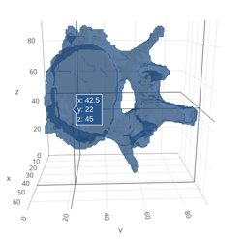
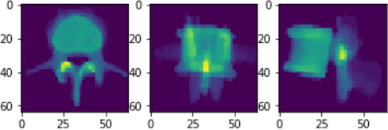
Datasets
Two public and one private
XVertSeg: 124 lumbar vertebrae masks. Non-fractured and fractured.
CSI 2014: 340 thoracic and lumbar masks
In-house from Klinikum Rechts der Isar: 962 thoracic and lumbar
Sum along each axis of a resized 64x64x64 vertebrae
3D visualization

Slide 5
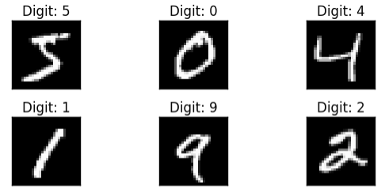
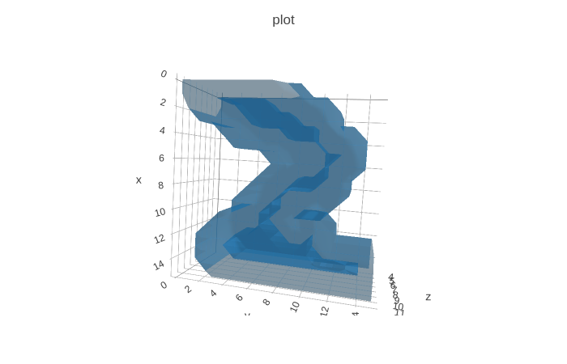
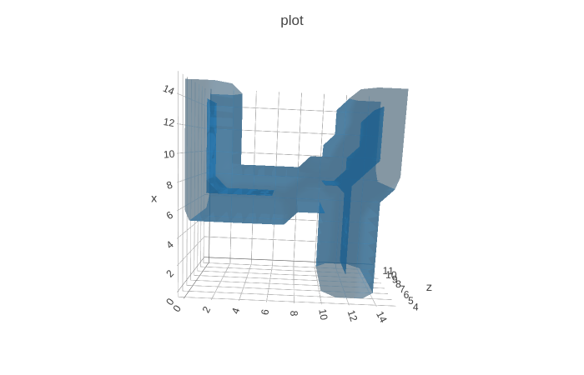
Toy Datasets
2D-MNIST
3D-MNIST

Slide 6
Variational Autoencoders (VAEs)

Slide 7
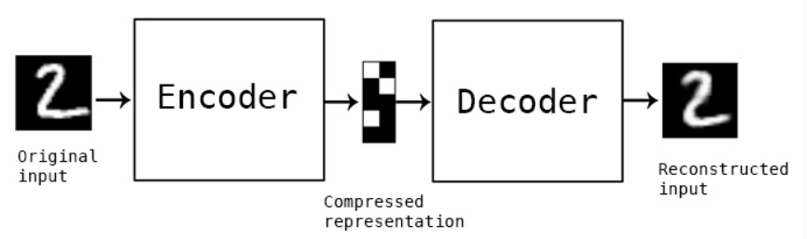
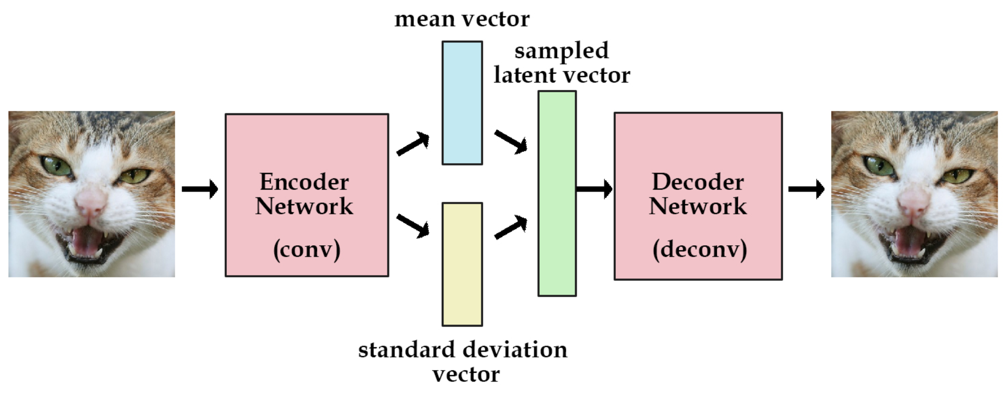
VAE^{[1]}
Squeezes information through bottleneck (latent space)
Pushes latent space to be normally distributed
[1] Auto-Encoding Variational Bayes . Kingma D. Welling Ma. 2013

Slide 8
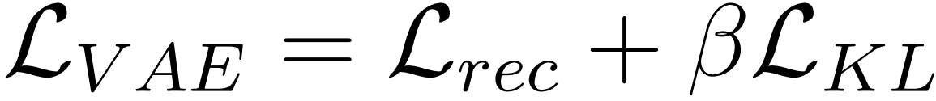
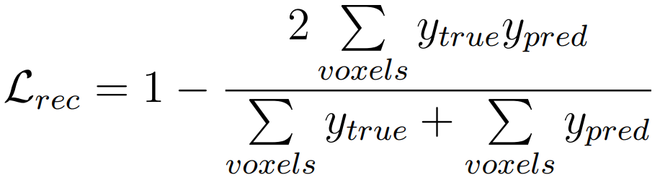
VAE - Loss
Two terms
Reconstruction Loss: measure of input-output similarity
Kullback–Leibler divergence to test how close the learned Gaussians are to unit Gaussians.
Original VAE: Binary Cross Entropy for reconstruction and β= 1
Since we have masks, we tried "Soft" Dice Loss^{[2][3]}
[2] The Importance of Skip Connections in Biomedical Image Segmentation. Drozdzal M. Vorontsov E. Chartrand G. Kadoury S. Pal C. 2016
[3] V-Net: Fully Convolutional Neural Networks for Volumetric Medical Image Segmentation. Milletari F. Navab N. Ahmadi S. 2016

Slide 9
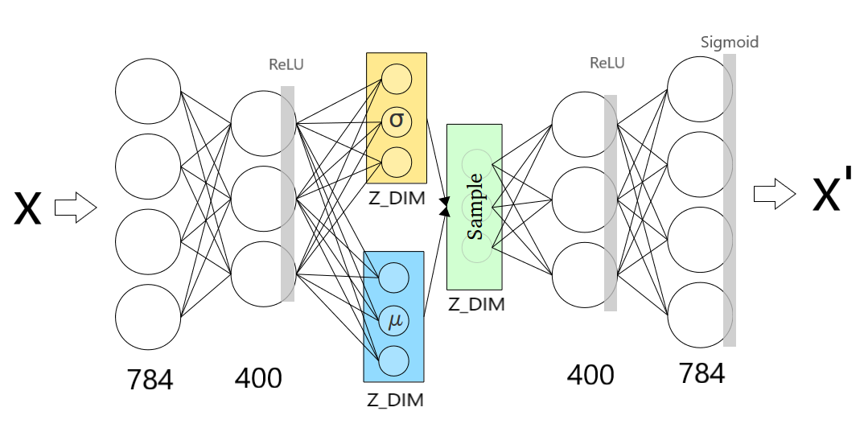
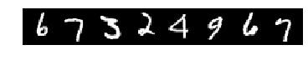
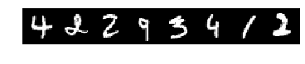
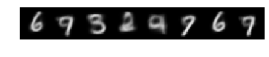
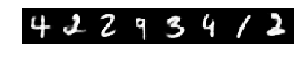
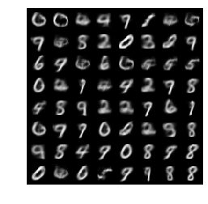
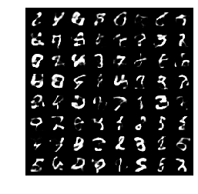
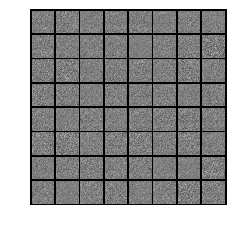
VAE – MNIST
Simple VAE
After 30 epochs
Z_DIMS=2
Z_DIMS=20

Slide 10
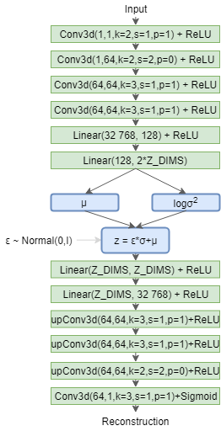
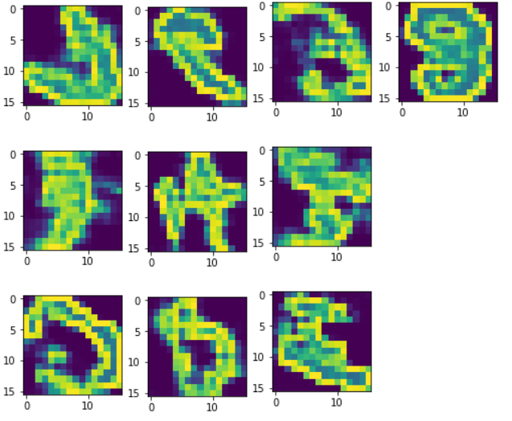
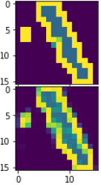
VAE – 3D-MNIST 16x16x16
Results from training 200 epoch with Z_DIMS=20
Adam (default), LR=1e-3
Reconstruction Loss = Binary Cross Entropy
KL distance: beta=1/(16*16*16)

Slide 11
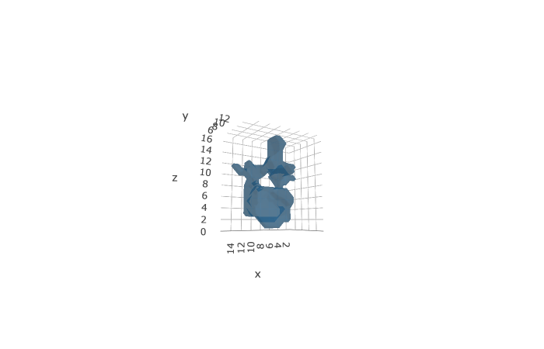
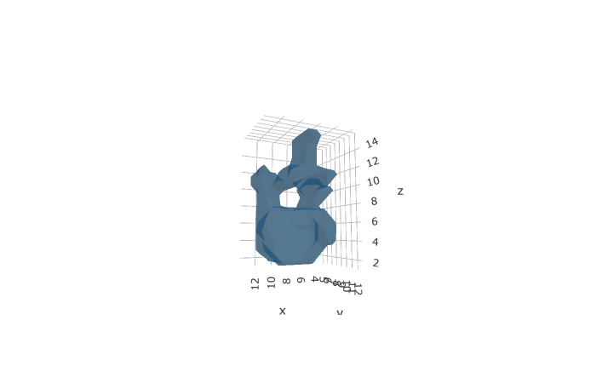
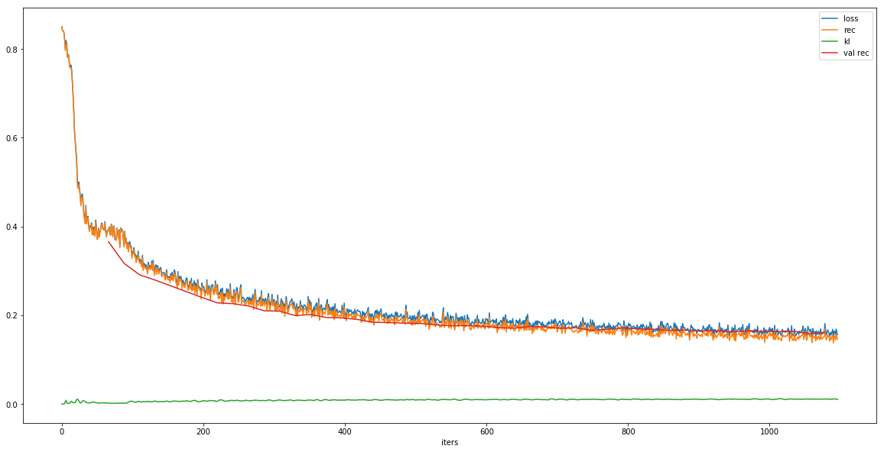
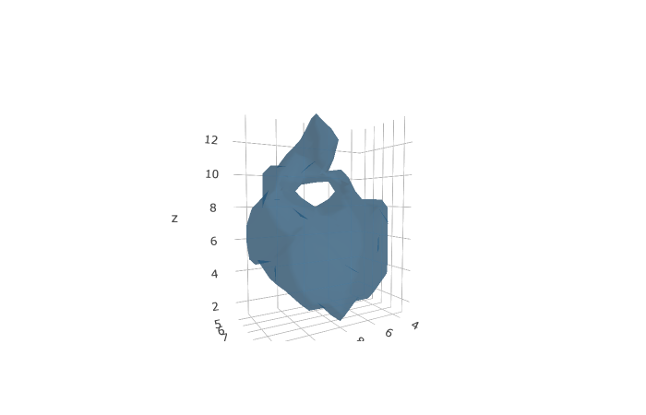
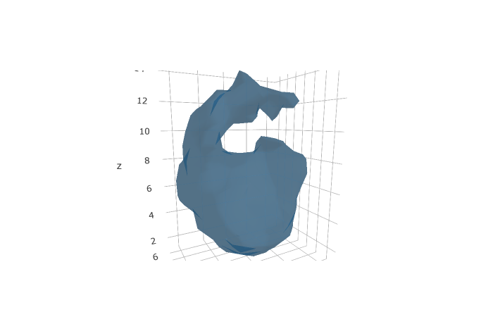
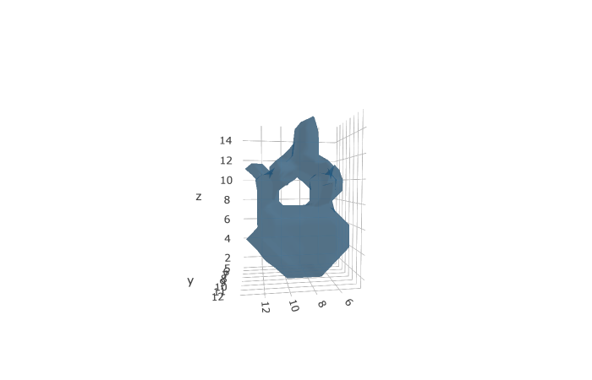
VAE – Vertebrae 16x16x16
Reconstructions
50 epochs, Z_DIMS=20
Reconstruction Loss = Soft Dice Loss
KL distance: beta = 1/(16*16*16)
Generations

Slide 12
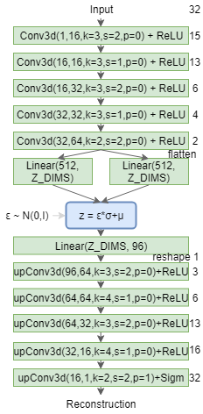
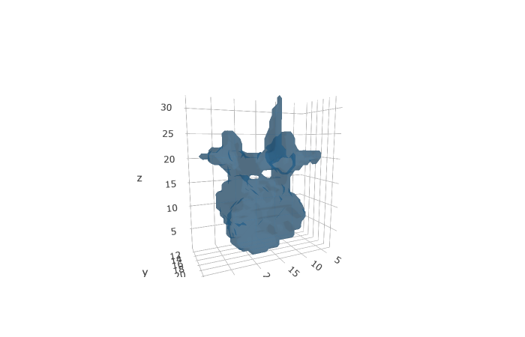
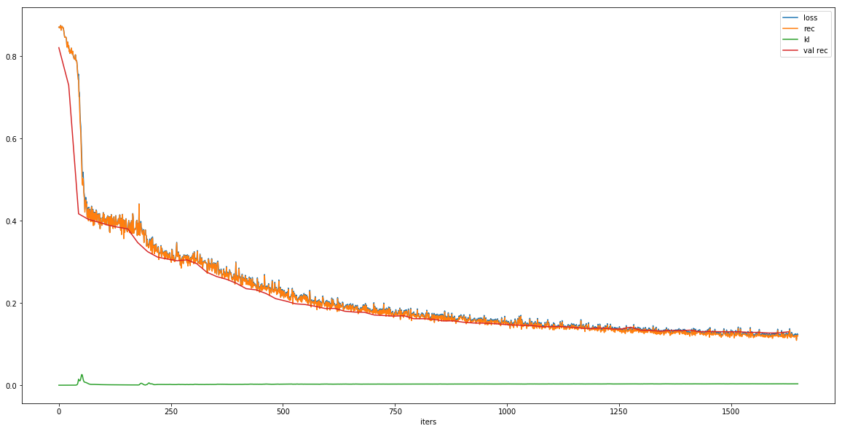
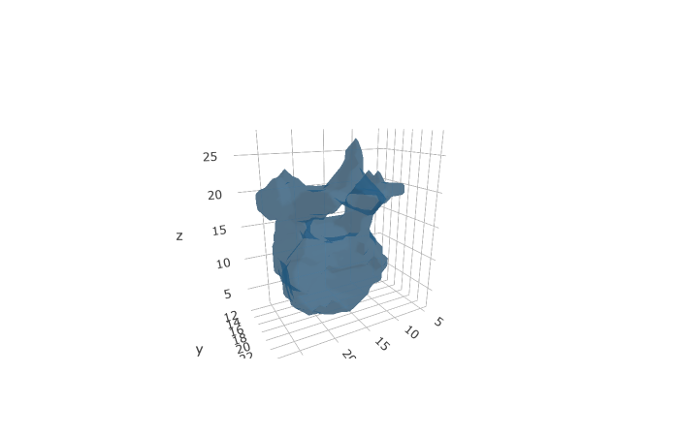
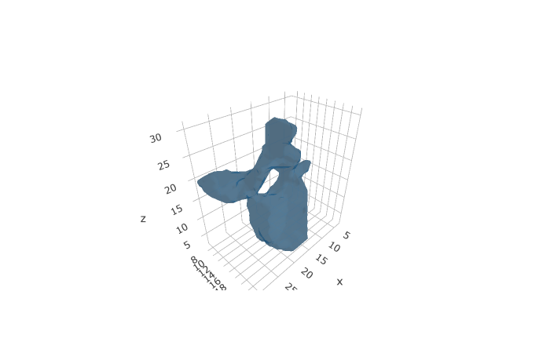
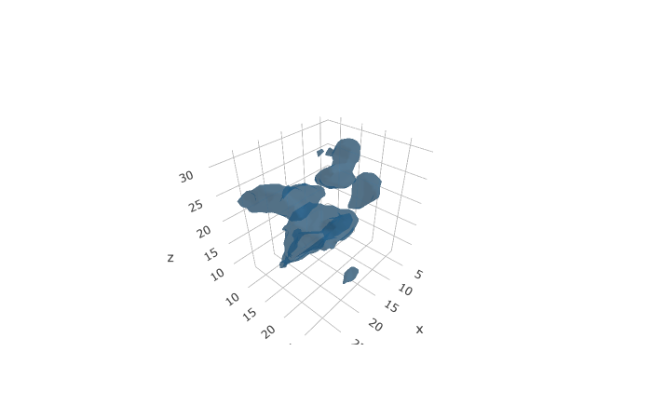
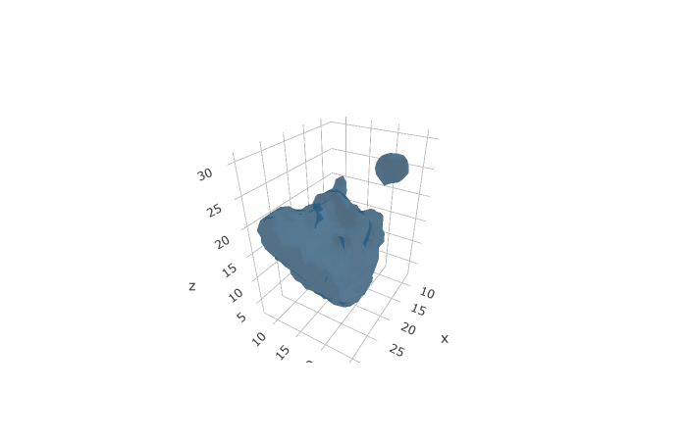
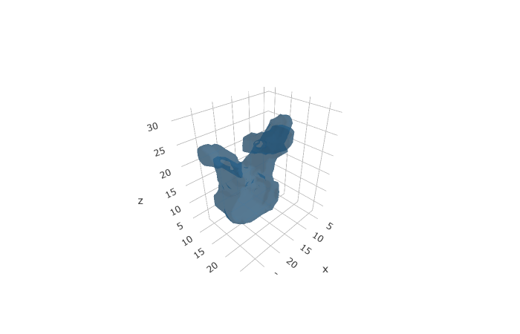
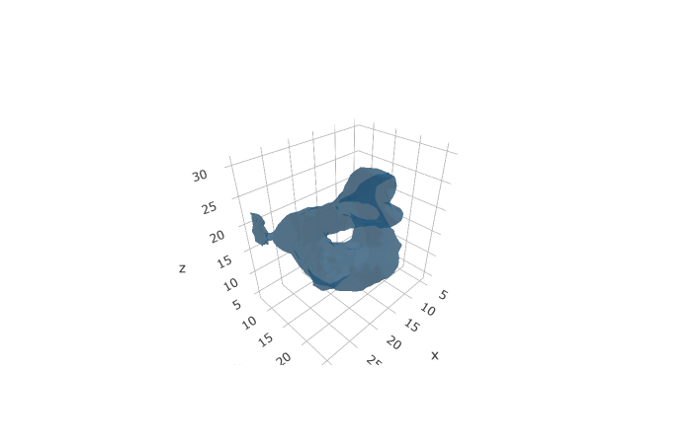
VAE – Vertebrae 32x32x32
Architecture inspired by [4]
75 epoch, Z_DIMS=32, Adam, LR=1e-3
Reconstruction Loss = Soft Dice Loss
KL distance: beta = 1 / (32*32*32)
Kaiming Uniform init
Reconstructions
Generations
[4] Learning Interpretable Anatomical Features Through Deep Generative Models: Application to Cardiac Remodeling . Biffi et al. 2018

Slide 13
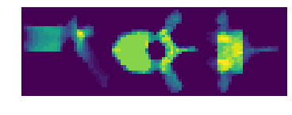
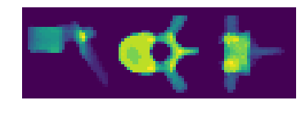
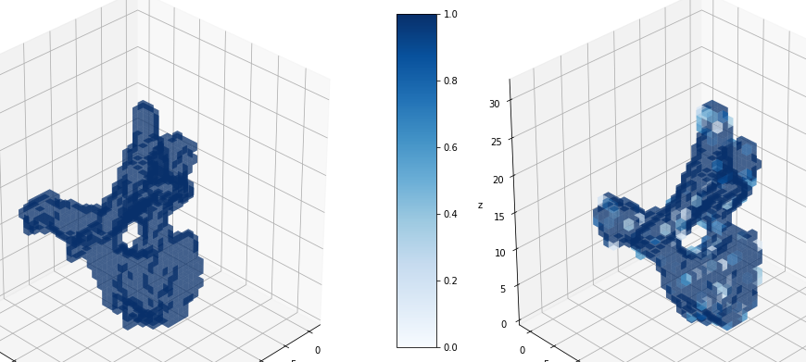
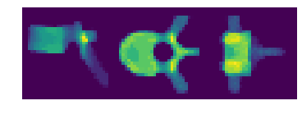
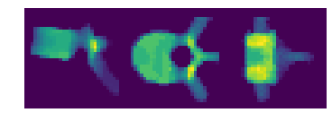
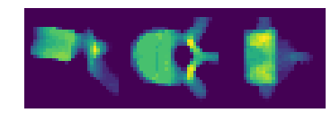
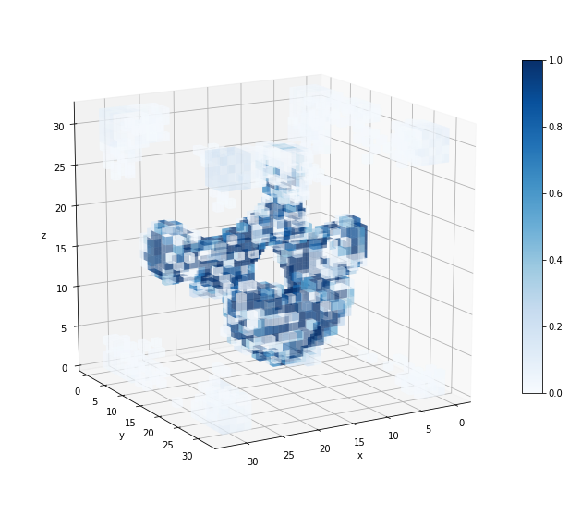
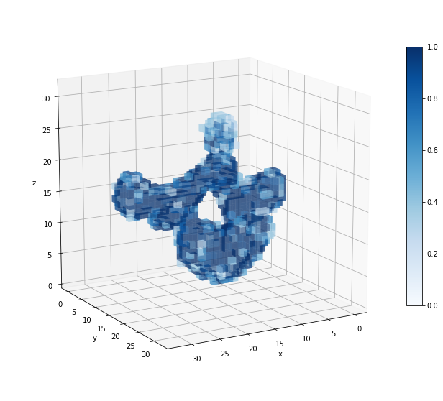
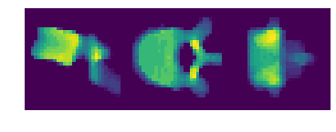
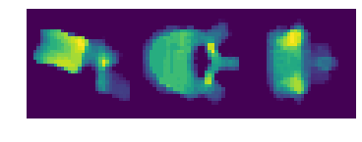
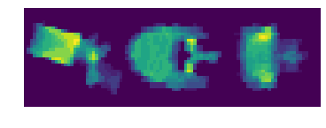
VAE – Vert32 cont.
Latent space interpolation
Validation samples in dashed boxes.
Latent space looks smooth
Mask's voxels have very high probability
eps=1e-5
Generation
eps=0.01
eps=0.25

Slide 14
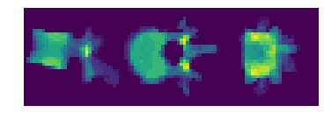
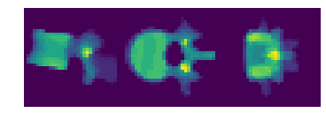
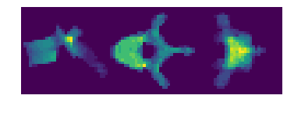

Conclusions
Trained only lumbar, 125epochs
VAE manages to reconstruct well to resolution 32. Shows potential for higher resolutions.
Can try anomaly detection based on VAE loss or reconstruction probability. [5][6]
Lumbar (orig/rec)
Thoracic (orig/rec)
[5] Variational Autoencoder based Anomaly Detection using Reconstruction Probability. An Jinwon, Cho Sungzoon 2015
[6] Anomaly Detection for Skin Disease Images Using Variational Autoencoders. Lu Yucheng, Xu Peng 2018

Slide 15
Generative Adversarial Networks (GANs)

Slide 16


NOT THESE GANs
GANs at Google
GANs in ALDI

Slide 17

But THESE GANs^{[6]}
Minimax Game
GANs at TUM
[6] Generative Adversarial Nets, Ian J. Goodfellow, Jean Pouget-Abadie, Mehdi Mirza, Bing Xu, David Warde-Farley, Sherjil Ozair, Aaron Courville, Yoshua Bengio, 2014
Notes:
On one side:
D tries to maximize the probability that any real data point is classified as belonging to the dataset.
At the same time it minimizes the probability that any fake data point is classified as belonging to the real data set.
On the other side:
G tries to maximize the probability that the samples it generates is classified as belonging to the dataset.

Slide 18

DC GAN
We use variants of this architecture for the generator.
[source] https://www.researchgate.net/figure/Architecture-of-proposed-generator-network-which-is-part-of-GAN-based-on-CNN-units-with_fig19_319093376

Slide 19

3D-GAN
We use variants of this architecture for the generator.
[Source] http://3dgan.csail.mit.edu/

Slide 20





Vanilla GANs (Results)
2D MNIST
3D MNIST
Training for 200 epoch. 60K training example
lr_g, lr_d = (0.0017, -0.00072)
3D-GAN network structure
Training for 600 epoch. 5K training example.
Unstable training. lr_g, lr_d = (0.0025, 1e-3)
Optimizer Adam with momentums (0.5,0.5)

Slide 21



Pitfalls of Vanilla GAN
Minimizing the GAN objective function with an optimal discriminator is equivalent to minimizing the JS-divergence.
If the generated samples' distribution q is far away from P (real distribution), the gradient vanishes, I.e. generator learns nothing.
Lets modify this generator loss
Unstable with large Varience of gradients
Notes:
Optimal discriminator produces good information for the generator to improve. But if the generator is not doing a good job yet, the gradient for the generator diminishes and the generator learns nothing (the same conclusion we just explain).
1- original Generator loss function in vanilla gan
2- modified generator loss in vanilla gan

Slide 22


Wasserstein GAN^{[5]}
Wassterstein Distance / EarthMover distance
The minimum cost of transporting mass in converting the data distribution q to the data distribution p.
In WGAN, the gradient is smoother everywhere and learns better evenif the generator is not producing good images.
[4] Wasserstein GAN, Martin Arjovsky, Soumith Chintala, and L´eon Bottou, 2017

Slide 23

WGAN Results
2D MNIST
* WSGAN was not able to approximate the distribution of 3D MNIST dataset and the training was diverging on all possible variants of the network.

Slide 24



WGAN Results
Vertebrae 16x16x16
3D-GAN structure
Training for 200 epochs
Objective function : WSGAN-GP
Latent space dim = 100
100 epochs
200 epochs

Slide 25














WGAN Results
Vertebrae 16x16x16

Slide 26







Latent Space Interpolation
Starting Sample
Target Sample
Awesome :) !

Slide 27
Conclusion
GANs:
Vanilla GANs are capable of good generations but suffer from instability and variance.
WSGAN is a more stable version of the GAN, and the more you train the higher quality you get (dataset dependent).
Training datas' distribution plays a huge rule on the convergence of the GANs.

Slide 28
Next Steps

Slide 29
Next Steps
VAEs:
Get good results at 64 cube lengths
Try anomaly detection based on reconstruction probability
GANs:
Move to 32, and 64 cube lengths using the WSGAN objective.
Switching to progressive growing GAN for higher resolutions.
General:
Compare results of two approaches, continue with the more promising.
Moving to the conditional variants of chosen approach based on the result of comparison.
Training a deep net on the generated vertebra to detect fractures (Ultimate goal)

Slide 30


Progressively Growing GANs
We intend to reach this stage (128x128 pixels)

Slide 31

One last thing
Thanks COLAB, we hate you, you are just not perfect :(

Slide 32
Thank you!
*Many thanks to Anjany for his great support and flexibility.

Slide 33











VAE
Effect of Beta
Beta=1
Using BCE Loss for reconstruction, low probs.
Beta=1e-5

